Slide 1
Regular expressions & NFA
Dr G Sudha Sadasivam

Slide 2
Agenda
Regular expressions
Simplification & rules
Automaton
NFA
RE to NFA conversion

Slide 3
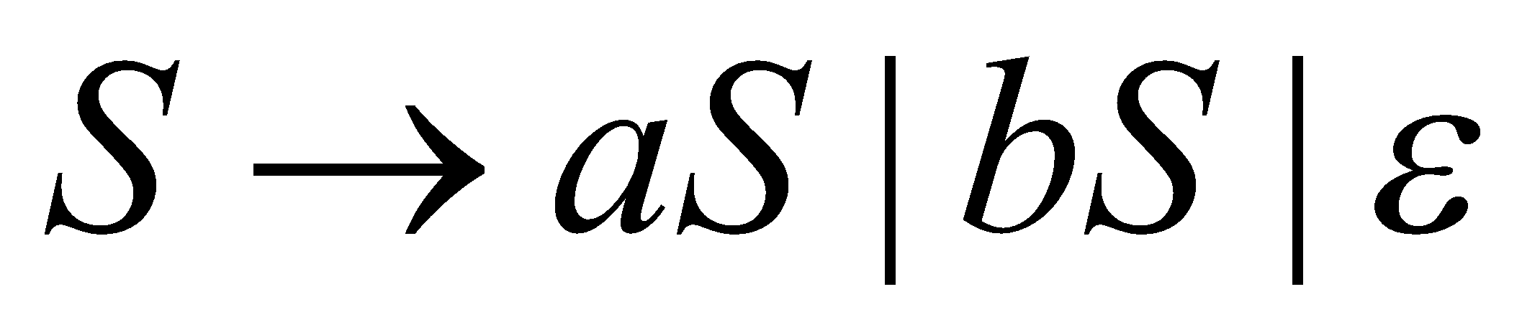
Type 3 or Regular Language
RG generate language accepted by Finite Automaton
Production / Rules for Type 3 grammar is of the form
A → a | aB
Grammar for L generating all strings belonging to Σ = {a,b}
Generating string “abb”
Every Type i Language is of Type i-1

Slide 4
If Σ is an alphabet, the set R of regular languages over Σ is defined as follows.
1. The language ∅ is an element of R, and
for every a ∈ Σ, the language {a} is in R.
2. For any two languages L1 and L2 in R, the three languages
L1 ∪ L2, L1L2, and L∗ are elements of R.
Set builder and Roaster notations express languages
Third way is using regular expressions to represent regular grammars
Operators in regular expressions | . and * to represent union, concat and zero or more repetitions
Any number of 0s one 1 any number of 0s one 1
any number of 0s
0* . 1 . 0* . 1 . 0* → 0*10*10*

Slide 5
RE definition
Basis 1: If a is any symbol, then a is a RE, and L(a) = {a}.
Note: {a} is the language containing one string, and that string is of length 1.
Basis 2: ε is a RE, and L(ε) = {ε}.
Basis 3: ∅ is a RE, and L(∅) = ∅.
Induction 1: If E₁ and E₂ are regular expressions, then E₁ | E₂ is a regular expression, and L(E₁|E₂) = L(E₁)∪L(E₂).
Induction 2: If E₁ and E₂ are regular expressions, then E₁E₂ is a regular expression, and L(E₁E₂) = L(E₁)L(E₂).
Induction 3: If E is a RE, then E* is a RE, and L(E*) = (L(E))*.
* - Kleene closure operator (zero / more repetitions)

Slide 6
Precedence of operators:
Parentheses may be used wherever needed to influence the grouping of operators.
Order of precedence is * (highest), then concatenation, then | (lowest).

Slide 7
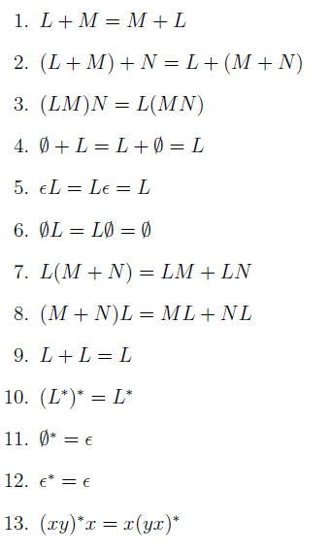
Regular expression identities
(L+M)*= (L*+M*)*= (L*M*)*
L and M are two Reg expr

Slide 8
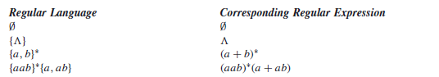
Examples
|
|
L(01) = {01}.
L(01+0) = {01, 0}.
L(0(1+0)) = {01, 00}.
L(0*) = {ε, 0, 00, 000,… }.
L((0+10)*(ε+1)) =all strings of 0’s and 1’s without two consecutive 1’s.

Slide 9
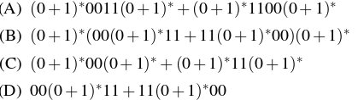
all strings of 0’s and 1’s having 101 as a substring
(0+1)*101(0+1)*
all strings of 0’s and 1’s having 101 as a subsequence
(0+1)*1(0+1)*0(0+1)*1(0+1)*
all strings of 0’s and 1’s having a number of 0’s that is a multiple of 3.
1*(1*01*01*01*)*1*
Strings which either have 0011 or 1100 as substring.
Strings which either have 00 or 11 as substring.
Strings which start with 11 and end with 00 or start with 00 and end with 11.
set of all binary strings having two consecutive 0s and two consecutive 1s

Slide 10
Give equivalent RE for (00)*(ε+0) (00)*(ε+0) = (00)*.ε+ (00)*.0 = (00)* + (00)*0 = 0*
Which of the following strings would match the regular expression : p+ [3 – 5]∗ [xyz]?
p443y II. p6y III. 3xyz IV. p35z V. p353535x VI. ppp5
3) Consider the following identities for regular expressions: (a) (r + s)* = (s + r)* (b) (r*)* = r* (c) (r* s*)* = (r + s)*

Slide 11
Exercises
Strings of even length
Strings with odd number of 1’s
Strings ending with 1 and not containing 00
(0+ε) (10+11)* 1
Identifier (_|l) (l | d )*
L={1^{n}0^{m} | n+m is even}
Even number of 0’s followed by odd number of 1’s
Begin with 110
Begin with 1 followed by any number of 0’s or a single 1
All strings with no more than 3 ones
Show the equivalence of the following RE
(0+1+00)* = (0+1)*
1*(011)* [1*(011)* ]* =( 1 + 011)*
Simplify the following RE
(aa)*(bb)*b

Slide 12
Automaton
Parking payment (Rs 10, Rs 5). Parking cost is Rs 25
Rs 5
Rs 10
q0
q5
q20
q25
q10
q15
start
acc
label
states
transitions

Slide 13
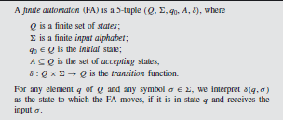
NFA
δ: Q x (∑ U ϵ} →2^{Q}
NFA :
a) Epsilon transitions
b) Can transit from same state and input to more than two states
A
1
B
δ(A,1) = B

Slide 14
RE to ε-NFA: Basis
Symbol a:
ε:
∅:
a
ε

Slide 15
RE to ε-NFA: Induction 1 – Union
For E₁
ε
ε
For E₂
ε
ε
For E₁ ∪ E₂

Slide 16
RE to ε-NFA: Induction 2 – Concatenation
For E₁
For E₂
ε
For E₁E₂

Slide 17
RE to ε-NFA: Induction 3 – Closure
ε
For E
ε
ε
ε
For E*

Slide 18
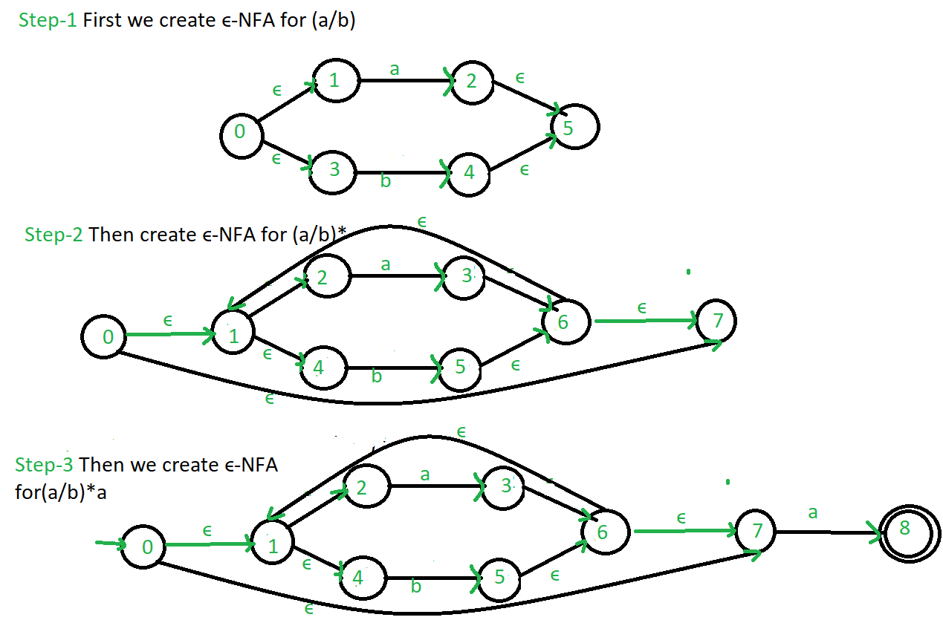
(a|b)* a

Slide 19
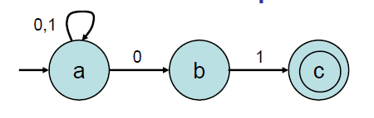
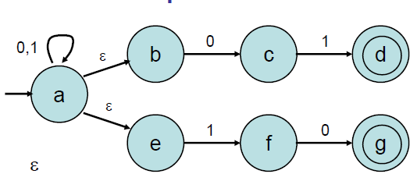

Slide 20

NFA acceptance
Accepts a string if some allowed sequence of
transitions on that string leads to an accepting
state.
Optionally follow any ε arrow at any time, without
consuming any input.
1
accept
1
reject

Slide 21
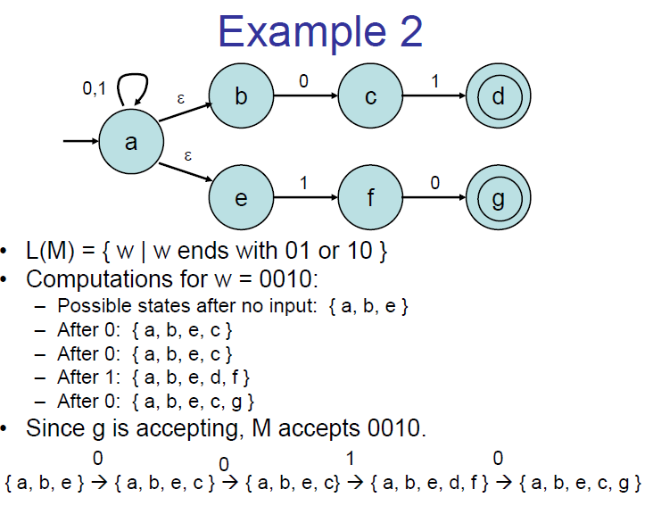

Slide 22
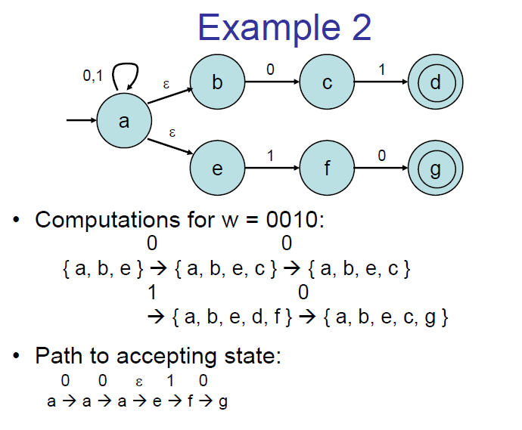
δ *( a, 0010) = δ(δ(δ(δ(a,0),0),1),0)
δ (δ(δ(a,0),1),0)= δ (δ(e,1),0))
= δ (f,0) = g

Slide 23
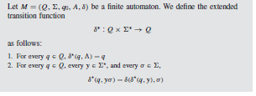

Slide 24
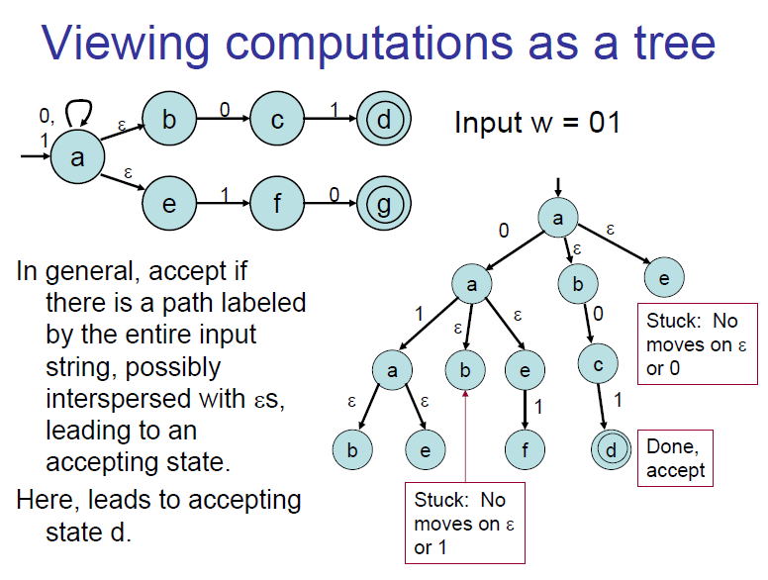

Slide 25
